Slide 1

ECE 382V: QUANTUM COMPUTING SYSTEMS:
A SOFTWARE/ ARCHITECTURE PERSPECTIVE
ERRORS And BENCHMARKING
Thanks to Prof. Moinuddin Qureshi & Prof. Swamit Tannu!
POULAMI DAS
ECE, The University of Texas at Austin

Slide 2
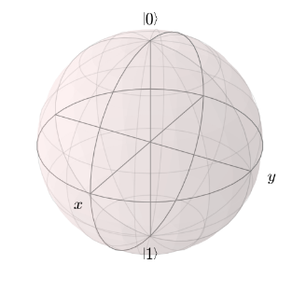
Decoherence: Qubits Lose Information Over Time
Decoherence: Qubit loses its information naturally due to its unwarranted interactions with the environment
1
1
Error
Probability of decoherence increases exponentially with time
0
0
Time Constant: Coherence Time
Time = 0
Time = t
Probability of Qubit
in the Correct State
Time
Phase information decays faster than amplitude information, therefore there are two different time constants (T₁ for amplitude and T₂ for phase, usually T₂<T₁)
Higher coherence times are desirable, depends on qubit technologies

Slide 3
Quantum Gate Operations Are Imperfect
Quantum gate operations cannot be applied with precise accuracy
1
Error
1
Quantum Gate
0
0
Error-rates typically in the range of 0.1-1 %
Error-rates of two-qubit gates are an order of magnitude higher than single qubit gates
Lower gate error rates are desirable

Slide 4
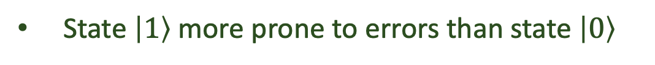
Quantum Measurements Are Error-Prone
Quantum measurements produce incorrect ‘classical’ outcomes
1
1
Error
0
Error-rates typically in the range of 1-4 %
30%
50%
Quantum Measurement
1
0
State $\left|1\right\rangle$ more prone to errors than state $\left|0\right\rangle$
0
70%
50%
Lower measurement errors are desirable

Slide 5
What Causes Hardware Errors?
Let us take the example of a measurement operation on a superconducting qubit
0
1
0
1
Measure
Software
Frequency shift is sensitive to noise
Discriminator
ADC
Hardware
Thermal noise
Amplifier
300 K
Long latency
SNR+
3-4 K
Resonator
Inaccurate classification
20 mK
Some noise sources are not yet completely understood, hard to fully eliminate at device-level

Slide 6
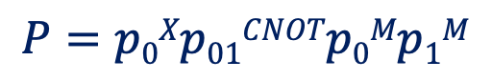

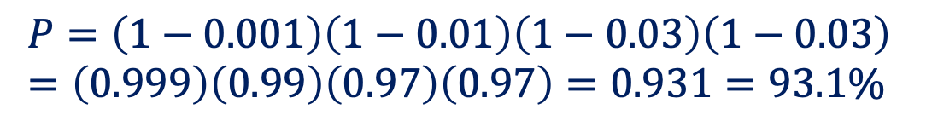
Analyzing The Impact Of Hardware Errors
Let $piop$ denote the probability of successfully executing operation $op$ on qubit $i$
0.1%
3%
1%
Let e$iop$ denote the probability of error while executing operation $op$ on qubit $i$
q0
X
M
$$piop=1−eiop$$
q1
+
M
Let $P$ denote the probability of successfully running the entire circuit
$$P=p0Xp01CNOTp0Mp1M$$
$$P=(1−e0X)(1−e01CNOT)(1−e0M)(1−e1M)$$
$$P=\left(1−0.001\right)\left(1−0.01\right)\left(1−0.03\right)\left(1−0.03\right) =\left(0.999\right)\left(0.99\right)\left(0.97\right)\left(0.97\right)=0.931=93.1\%$$
More accurate modeling by accounting for decoherence using exponential decay
High error-rates of quantum hardware limits us from running most practical quantum algorithms

Slide 7
Qubit Device Level Metrics
Gate Fidelities (single-qubit, two-qubit, reset)
Coherence times
Measurement Fidelities (states 0 and 1)
Crosstalk metrics (operations on one qubit affect operations on other qubits, challenge for concurrent operations during a program)
Gate latencies (determines length of a program and the probability of decoherence)
Spectator errors (operations on one qubit affects the state of an idle/spectator qubit
Not all qubits are created equal: Temporal And spatial variation In error-rates
What are the challenges if we want to compare qubits on two different machines?

Slide 8
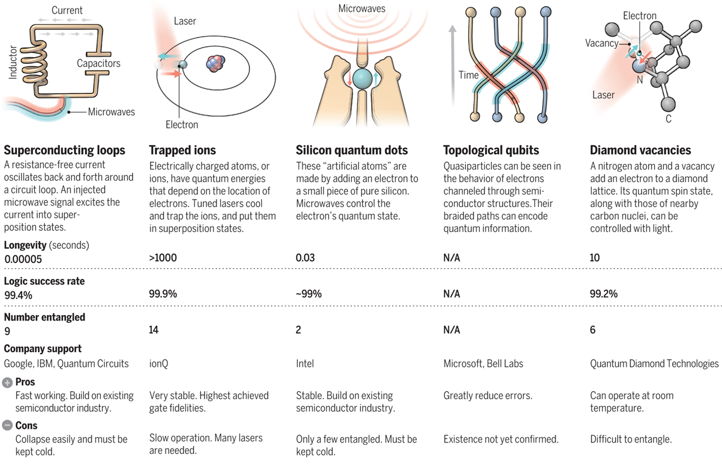
Different Qubit Device Technologies
What are the challenges if we want to compare qubits on two different machines using same qubit technology?

Slide 9
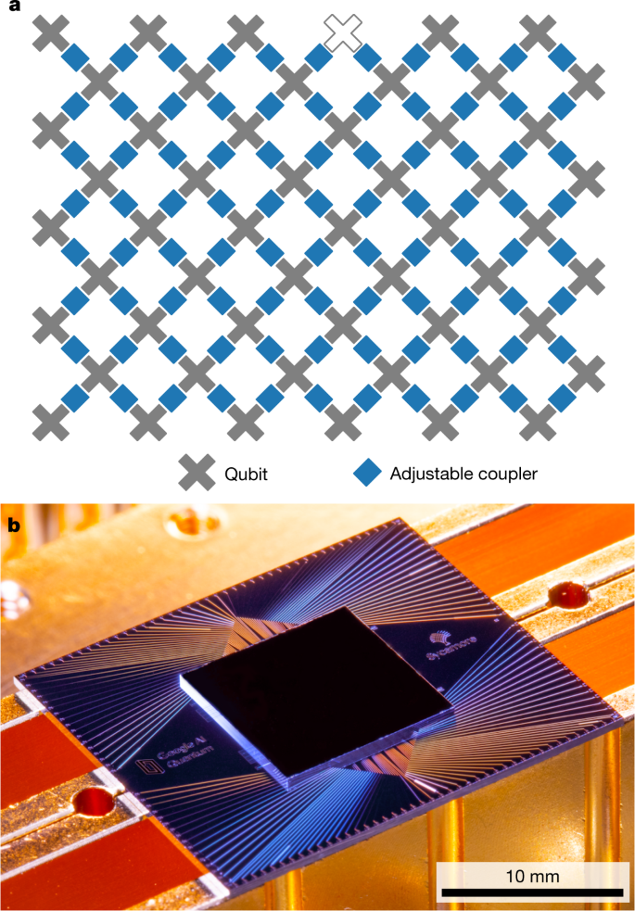
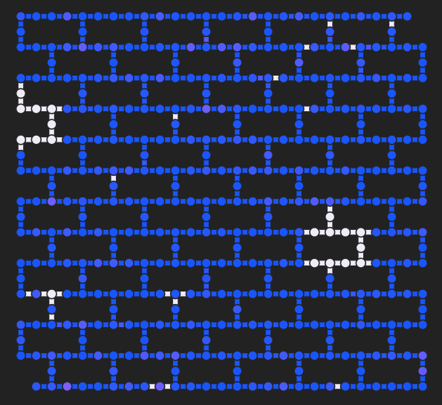
Different Systems Using Same Qubit Technology
Might be using completely different basis gates
Different ways of building the same qubit
IBM
Google
Benchmarking metrics for qubits are different from those used for quantum computers

Slide 10



Circuit Reliability/Fidelity Metrics
$$Probability of Successful Trial \left(PST\right)= \frac{Number of Trials Producing Correct Output}{Total Number of Trials}$$
q0
X
M
q1
+
M
Compile
Run
Log
Outcome
01
00
Program
Quantum
Executable
Quantum
Device
11
11
11
Repeat N trials
How to compute PST of a Bell-Pair circuit (multiple correct answers or output is a distribution)?

Slide 11
Distance-Based Metrics
$$Hellinger Distance=Measure of similarity or dissimilarity between two distributions$$
Bounded between 0 and 1
0
1
0
1
1
0
Prob.
Prob.
Prob.
a
b
a
b
a
b
Outcomes
Outcomes
Outcomes
D1
D2
D3
HD=0
HD=1
Total variational distance is also used
In order to compute PST or HD, the ideal output must be known

Slide 12
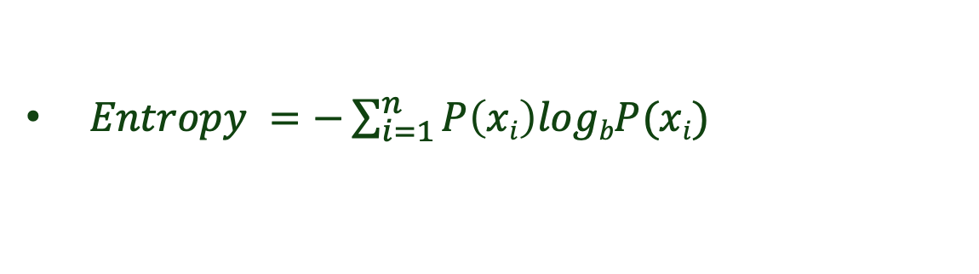
Entropy
Entropy is a measure of randomness (noise) in a system
Let $P\left(x\right)$ be the probability of sampling $x$
$Entropy =−\sum_{i=1}^{n}{P\left(xi\right)logbP(xi)}$
Entropy can be used to infer the amount of noise in a distribution

Slide 13


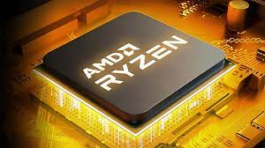
Why And How To Compare Two Quantum Computers?
Quantify and compare the effectiveness of one quantum hardware over another
Enables us to compare the performance of the software
Set technology milestones and track progress
Benchmarking is common even in classical systems
There are many caveats in benchmarking

Slide 14
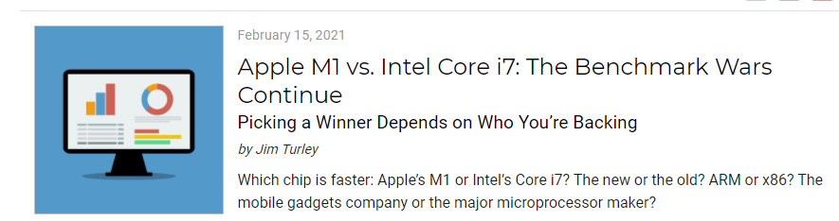

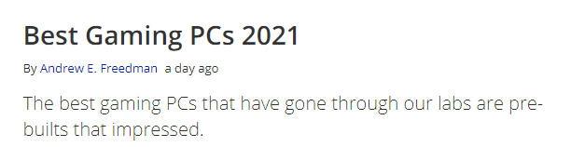
Analogy
Most suitable hardware for a given application
Best Hardware for on an average*
Classical-> execution time, Quantum-> reliability/ application fidelity

Slide 15
Quantum Volume [Introduced by IBM]
We need a metric that will capture – Number of qubits, gate fidelity, coherence time, connectivity, cross-talk, spectator errors ..
We want benchmarking circuits to be parametrizable as opposed to be fixed
IBM Quantum Volume satisfy above two properties
How to design quantum volume circuits?

Slide 16
Quantum Volume [Introduced by IBM]
Generate randomized circuits that produce output distribution (P)
In P, the heavy strings are output strings with higher than median probability of occurrence
Start with “x” qubits and “x” circuit depth, generate large number of random circuits
Run each circuit on simulator get list of heavy strings, then run on real machine, if real machine can produce 2/3 of the heavy strings then it’s a success
Try the same for “x+1”
Quantum volume = 2^{x}
Higher Quantum Volume (QV) is better

Slide 17
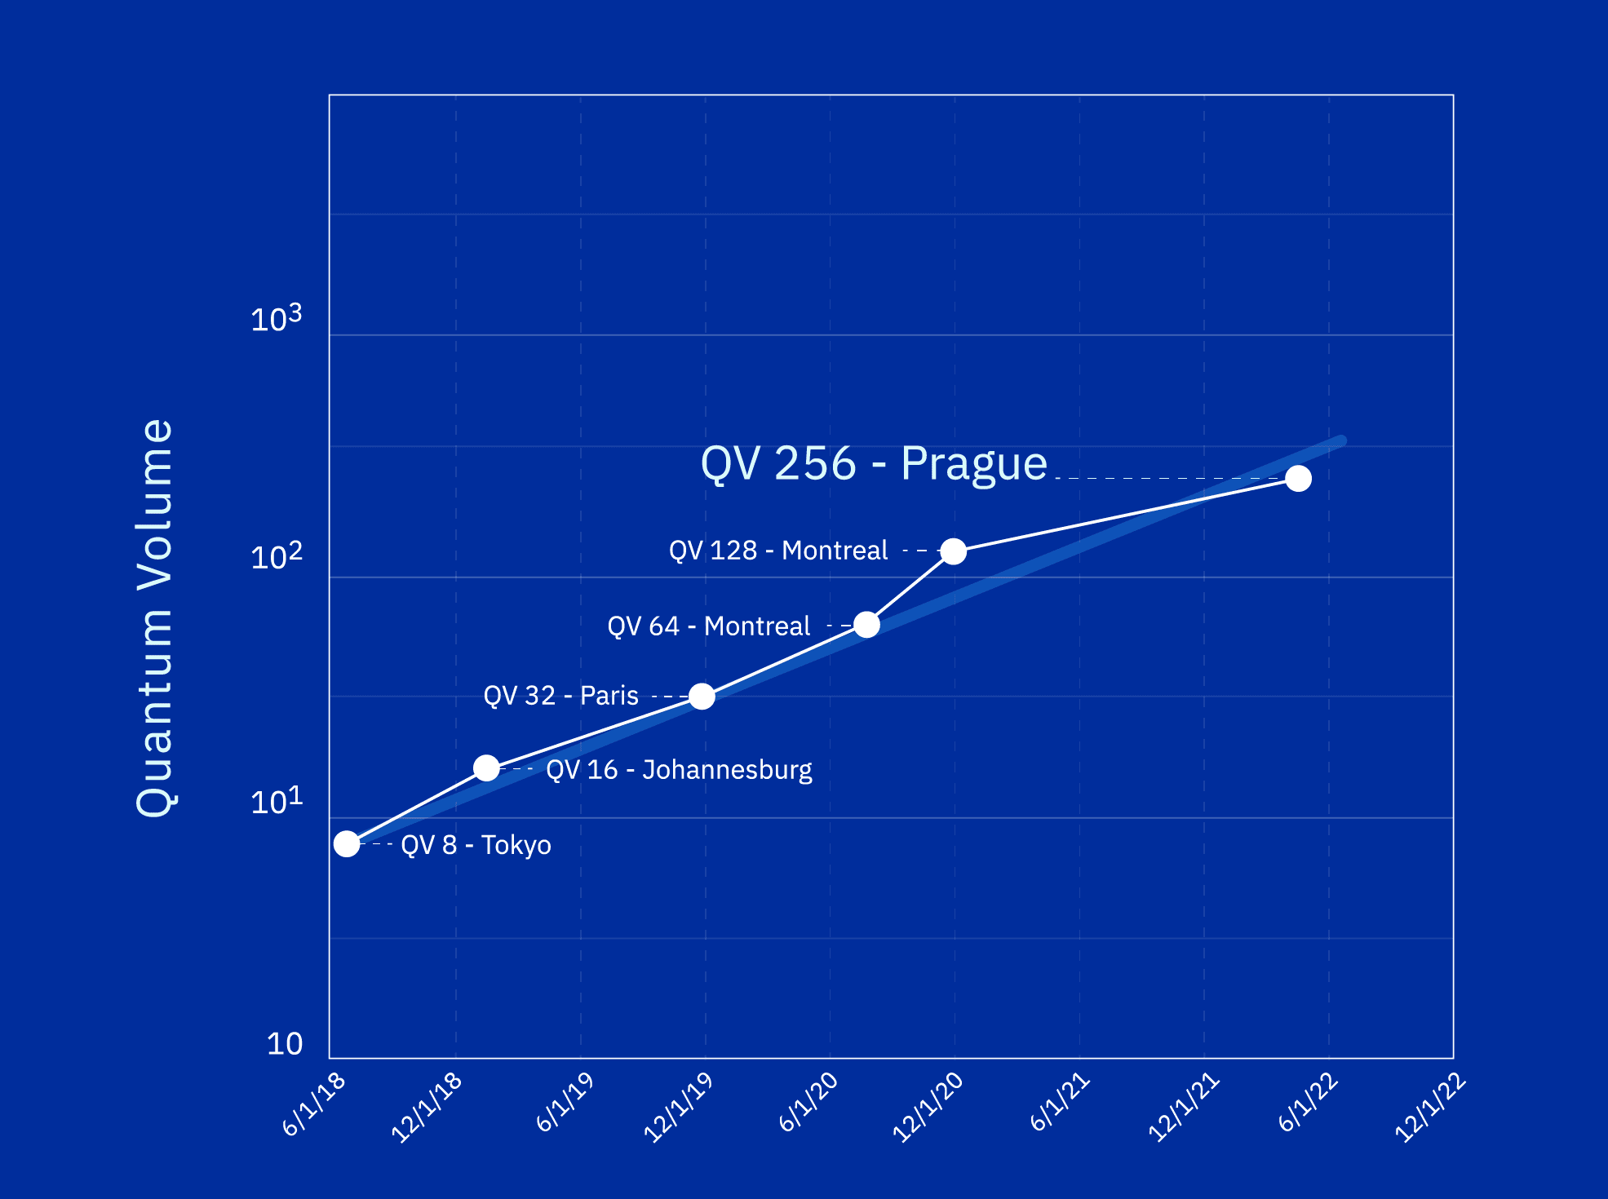
Quantum Volume Of IBM Hardware
What is the drawback of this approach?

Slide 18

Benchmarking vs. Randomized Benchmarking (RB)
“Benchmarking” is used in general-purpose computing to compare the performance of two different designs or impact of individual optimizations
Design-1: Given core model
Design-2: You enhance given core w/ security features
Which is better?
Are your enhancements causing slowdown?
“Randomized Benchmarking” is a protocol for characterizing the error-rates of different qubit devices and quantum operations (typically: granularity of single-qubit or two-qubit gates)
Randomized benchmarking corresponds to a finer granularity (and not full system)

Slide 19
Quantum System Calibration Using RB
Calibration of a quantum processor includes state and gate fidelity estimation, optimization of on-chip component parameters (such as qubit frequencies, coupler, and readout resonator frequencies), and finding the optimal control parameters for high-fidelity quantum gates
Randomized benchmarking enables us to estimate the error-rates
How many times did we get the correct state?
qubit
Identity
Repeated execution
Randomized benchmarking may be of different types (simple, interleaved)
The complexity of calibration scales with the system size
Notes:
Check out: https://www.youtube.com/watch?v=fk2HH9M4FqA
To learn more on calibration

Slide 20
SYSTEM CALIBRATION
CHALLENGEs
Thanks to Paul Klimov for sharing information about Google quantum systems!

Slide 21

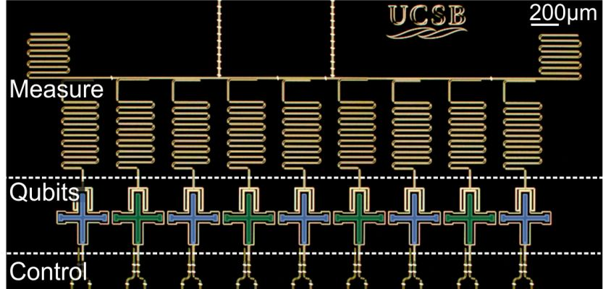
Xmon-Transmon Qubits
Xmon Qubit Circuit
XY line Resonator
Resonator for readout
XY line for microwave control
SQUID Z line for frequency control
Operate qubits from ~5 - 7 GHz
9 Qubit Processor
(2013)
SQUID
Z line
Self Cap.
Frequency Tunability
|1〉
~ 5 - 7 GHz
|0〉
Quantum gates are performed by applying pulses operating at dedicated frequencies
Notes:
Check out: https://www.youtube.com/watch?v=fk2HH9M4FqA
To learn more on calibration

Slide 22


Single Qubit Gates On Xmon Qubits
Single Qubit Gate:
Microwave Pulse
Single-qubit gates:
Microwave at idle frequency
|1〉
idle frequency
|0〉
R. Barends, J. Kelly, et al Nature 508, 500 (2014)
What about two-qubit gates?
Notes:
Check out: https://www.youtube.com/watch?v=fk2HH9M4FqA
To learn more on calibration

Slide 23

Two-Qubit Gates On Xmon Qubits
Fixed Coupling*
Two-qubit gates:
DC pulse to interaction frequency
Two-Qubit gate:
DC Current Pulses
interaction
frequency
|1〉
|1〉
|0〉
|0〉
R. Barends, J. Kelly, et al Nature 508, 500 (2014)
The gate frequency impacts the qubit qualities
Notes:
Check out: https://www.youtube.com/watch?v=fk2HH9M4FqA
To learn more on calibration

Slide 24
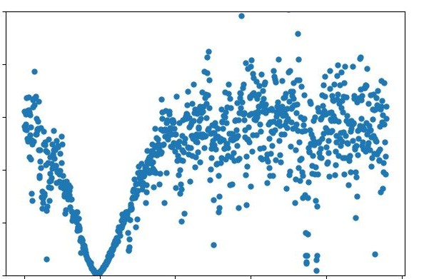
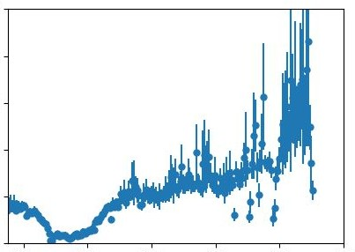
Impact Of Frequency Selection On Qubit Qualities
T₁ and T₂ show complex frequency dependence
Fluctuations by >10x over >10 MHz
Mainly originates from two-level system (TLS) defects which are still a mystery (dielectrics? Quasiparticles?)
0 T₁ (μs) 50
0 T₂ (μs) 100
Energy-Relaxation
Dephasing
 |  | 200 MHz
 |  | 10-100x
 |  | 200 MHz
 |  | 10x
5.4
Frequency (GHz)
6.4
5.4
Frequency (GHz)
6.4
The qubit frequencies must be carefully chosen
Notes:
Check out: https://www.youtube.com/watch?v=fk2HH9M4FqA
To learn more on calibration

Slide 25
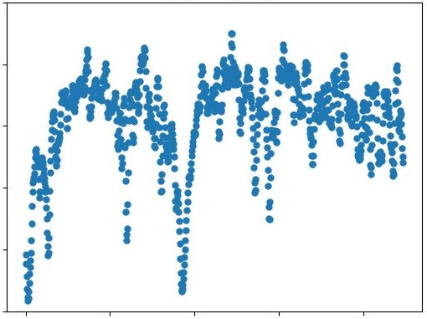
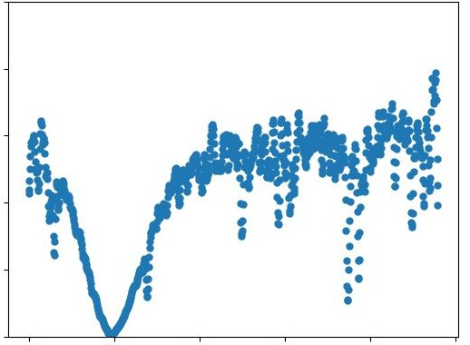
Constraints For Frequency Selection
0 T₁ (μs) 50 0 T₁ (μs) 50
0 T₁ (μs) 50 0 T₁ (μs) 50
0 T₁ (μs) 50 0 T₁ (μs) 50
To enable high fidelities, idle and interaction frequencies
Must avoid TLS during idles
Must avoid TLS during interactions
Must detune neighbor qubits during interactions
And many more…
idle
idle
0 T₁ (μs) 50
interaction
interaction
idle
idle
interaction
idle
idle
idle
5.4
Frequency (GHz)
6.4
5.4
Frequency (GHz)
6.4
5.4
Frequency (GHz)
6.4
5.4
Frequency (GHz)
6.4
Frequency calibration is non-trivial
Notes:
Check out: https://www.youtube.com/watch?v=fk2HH9M4FqA
To learn more on calibration

Slide 26
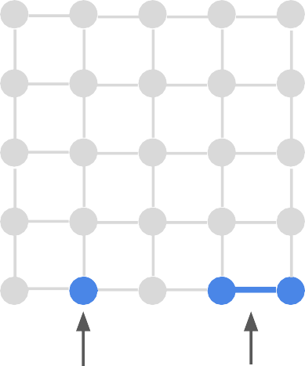
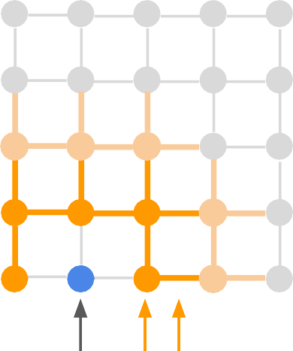
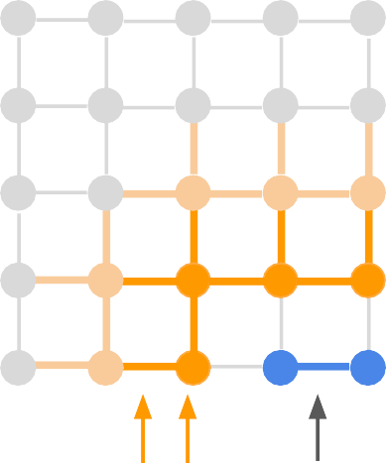
The Frequency Allocation Problem
Complexity
N idle frequencies
~2N interaction frequencies
For 100 qubits, ~100^{3N} options
Objective
Respect control hardware specs
Avoid TLS defects near idles, over interactions
Avoid parasitic coupling b/w nearby qubits
Processor
Processor
Processor
~50/idle
~100/interaction
idle
interaction
idle
parasitics
parasitics interaction
Freq. allocation is a high-dimensional, high-constraint, non-convex,time-dependent optimization

Slide 27
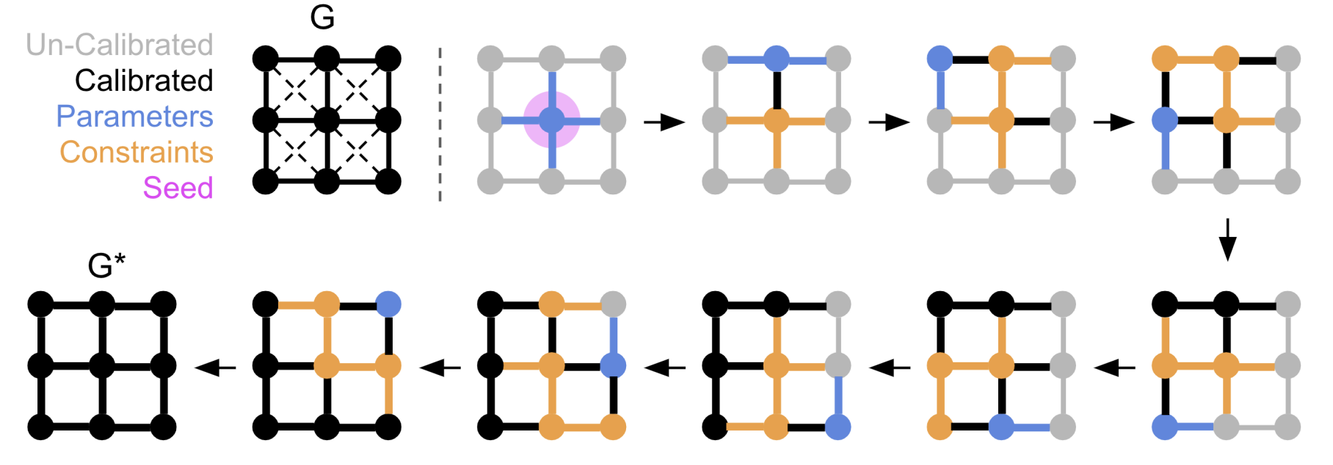
Snake Optimizer: Overview
When do you calibrate?
Managing system downtimes?
Managing drifts and recalibrations?
Paul Klimov, “The Snake Optimizer for Learning Quantum Processor Control Parameters”
Accurate and fast calibration at scale is an open problem

Slide 28


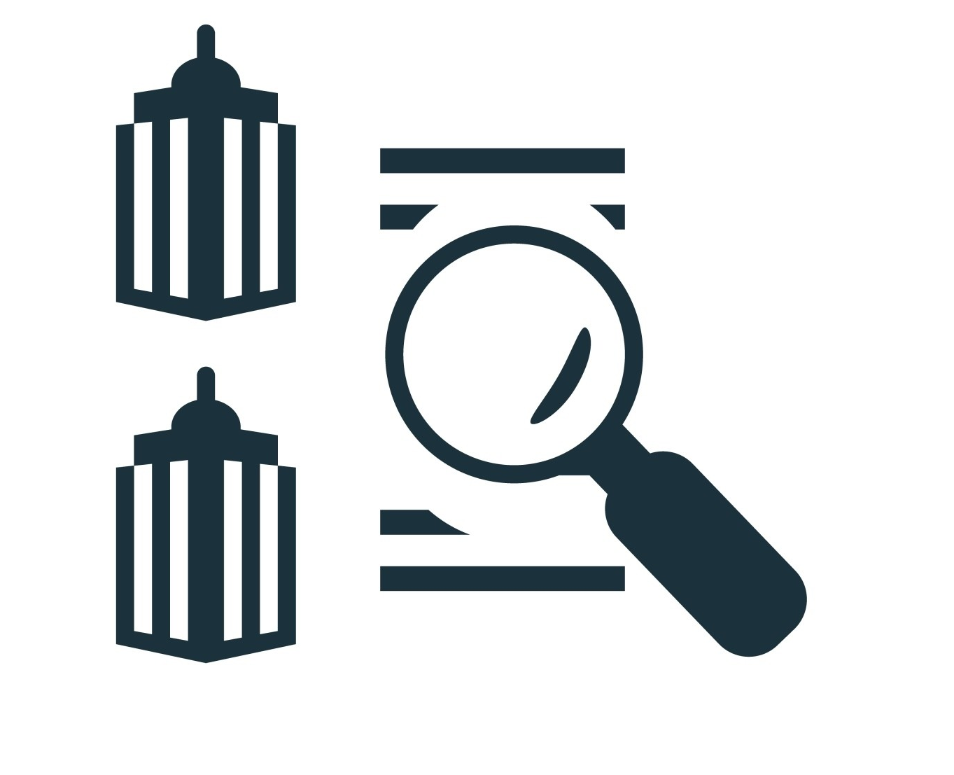

Summary
Error
Device level metrics
System-level metrics
Program-level metrics
Benchmarking/ Randomized Benchmarking
System Calibration

